Slide 1

CSC384 TUT9101

Slide 2
CSC384:Intro to artificial intelligence
TUT9101 Thursdays 9:10-10AM

Slide 3
CSC384 Tutorial 7: Bayesian Networks
A3 Office Hours
Problem 1
Discuss solution
Problem 2
Discuss solution
Questions?

Slide 4
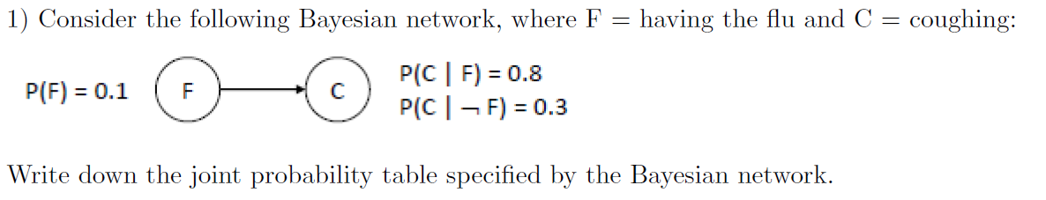

Slide 5
Solution
P(F,C) = P(C|F)P(F) = 0.8*0.1 = 0.08
Table:
F | C
t | t | 0.8*0.1 = 0.08
t | f | 0.1*0.2 = 0.02
f | t | 0.3*0.9 = 0.27
f | f | 1-0.08+0.02+0.27=0.63

Slide 6
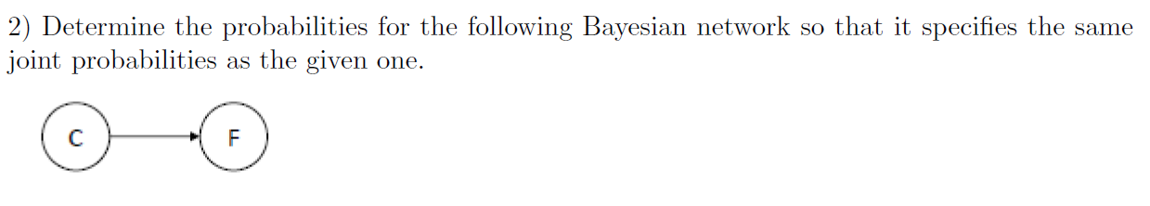

Slide 7
Solution
P(C)= 0.08+0.27=0.35
Recall Bayes Rule
P(F|C) = P(F,C)/P(C) = 0.08/0.35 = 0.23….
Do same with P(notC)
P(‘C)= 1-0.35 = 0.65
P(F|’C) = P(F,notC)/P(notC)=.02/0.65=0.03

Slide 8
3) Are C and F independent in the given Bayesian network (Question 1)?

Slide 9
Answer
No, since (for example) P(F) = 0.1 but P(F|C) = 0.23.
How about in the second Bayesian net?
No, since (for example) P(C) = 0.35 but P(C|F) = 0.08.

Slide 10
5) Which Bayesian network would you have specified using the rules learned in class?

Slide 11
The first one. It is good practice to add nodes that correspond to causes before nodes that correspond to their effects.

Slide 12
Problem 2

Slide 13
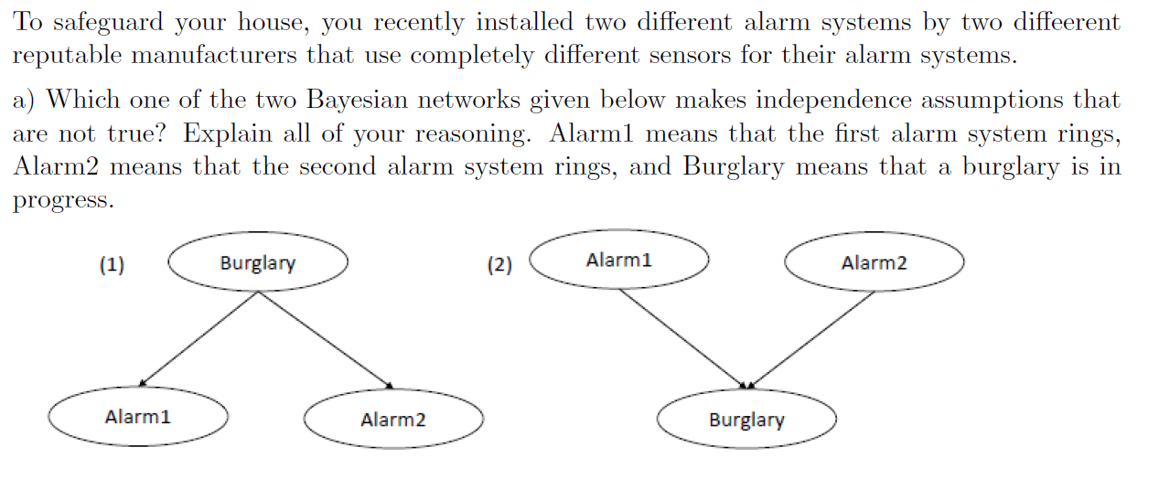

Slide 14
Solution
The second one falsely assumes that Alarm 1 and Alarm 2 are independent if the value of Burglary is unknown. However, if the alarms are working as intended, it should be more likely that Alarm 1 rings if Alarm 2 rings (that is, they should not be independent).

Slide 15
Consider the first Bayesian network. How many probabilities need to be specified for its conditional probability tables? How many probabilities would need to be given if the same joint probability distribution were specified in a joint probability table?
P(AandB)=P(A|B)P(B)

Slide 16
Solution
We need to specify 5 probabilities, namely P(Burglary), P(Alarm1|Burglary), P(Alarm1|not Burglary), P(Alarm2|Burglary), and P(Alarm2|not Burglary). A joint probability table would need 2³-1 = 7 probabilities.
B | A1 | A2
t | t | t
t | t | f
t | f | t
t | f | f
f | t | t
f | t | f
f | f | t
f | f | f

Slide 17
Any questions?

